Slide 1


NEXT GEN EMPLOYABILITY PROGRAM
CREATING A FUTURE-READY WORKFORCE
Student Name :
SHIVAM DUBEY
Student ID :
College Name :
STU609a4836a60161620723766
GITA Autonomous College

Slide 2
CAPSTONE PROJECT SHOWCASE
Project Title
FOOD ODERING APPLICATION
Abstract | Problem Statement | Project Overview | Proposed Solution | Technology Used | Modelling & Results | Conclusion | Q&A

Slide 3
Abstract
1
Project Overview – A food ordering application built using the MERN stack (MongoDB, Express.js, React.js, Node.js) to provide a seamless online food ordering experience.
2
Features - User authentication, restaurant and menu browsing, cart management, secure payments, and real-time order tracking.
3
Technology Stack – Frontend: React.js, Tailwind CSS, Redux Toolkit, Bootstrap; Backend: Node.js, Express.js, MongoDB.
4
Objective – To create a user-friendly, efficient, and scalable food ordering platform that enhances customer convenience and restaurant management.

Slide 4


Problem Statement
Limited online access – Traditional food ordering is inconvenient.
Manual order handling – Leads to delays and errors.
No real-time tracking – Customers lack order updates.
Payment issues – Insecure and inefficient transactions.
Slow processing – Existing systems struggle with high traffic.
Poor user experience – Unattractive and difficult-to-use interfaces.
Lack of restaurant management – Difficulty in menu and order updates.

Slide 5

Project Overview
Project Name – Food Ordering Application using MERN Stack.
Objective – Provide a seamless online food ordering experience.
Tech Stack – React.js, Tailwind CSS, Redux Toolkit, Bootstrap (Frontend); Node.js, Express.js, MongoDB (Backend).
Features – User authentication, menu browsing, cart management, payments, and real-time order tracking.
Target Users – Customers, restaurants, and admins for efficient order management.
Outcome – A scalable, secure, and user-friendly food ordering platform.

Slide 6
Proposed Solution
Online Platform – A web-based food ordering system for easy access.
Automated Order Management – Efficient order processing and tracking
Real-Time Tracking – Users can track their orders live.
Secure Payments – Integrated safe and seamless payment options.
User-Friendly Interface – Simple and attractive UI for better experience.
Scalable & Fast – Optimized for high performance and multiple users.
Restaurant Management – Easy menu updates and order handling.

Slide 7
Technology used
Frontend:
React.js – For building a dynamic and interactive UI.
Tailwind CSS – For responsive and modern styling.
Redux Toolkit – For state management.
Bootstrap – For additional UI components and styling.
Backend:
Node.js – For server-side logic.
Express.js – For handling API requests and routing.
Database:
MongoDB – For storing user, order, and menu data.

Slide 8
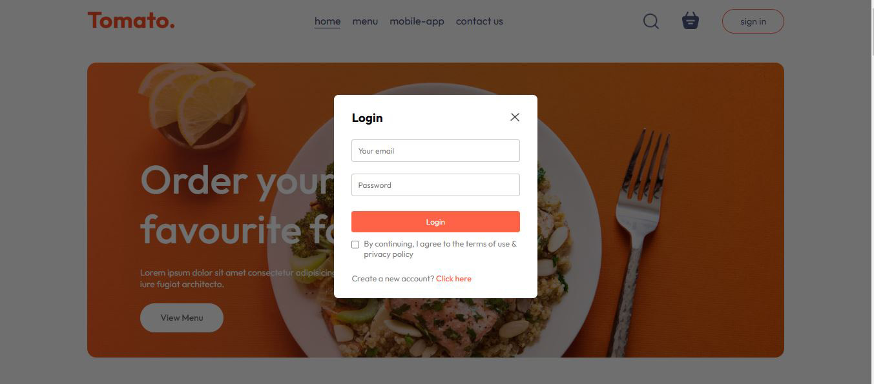
Modelling & Result

Slide 9
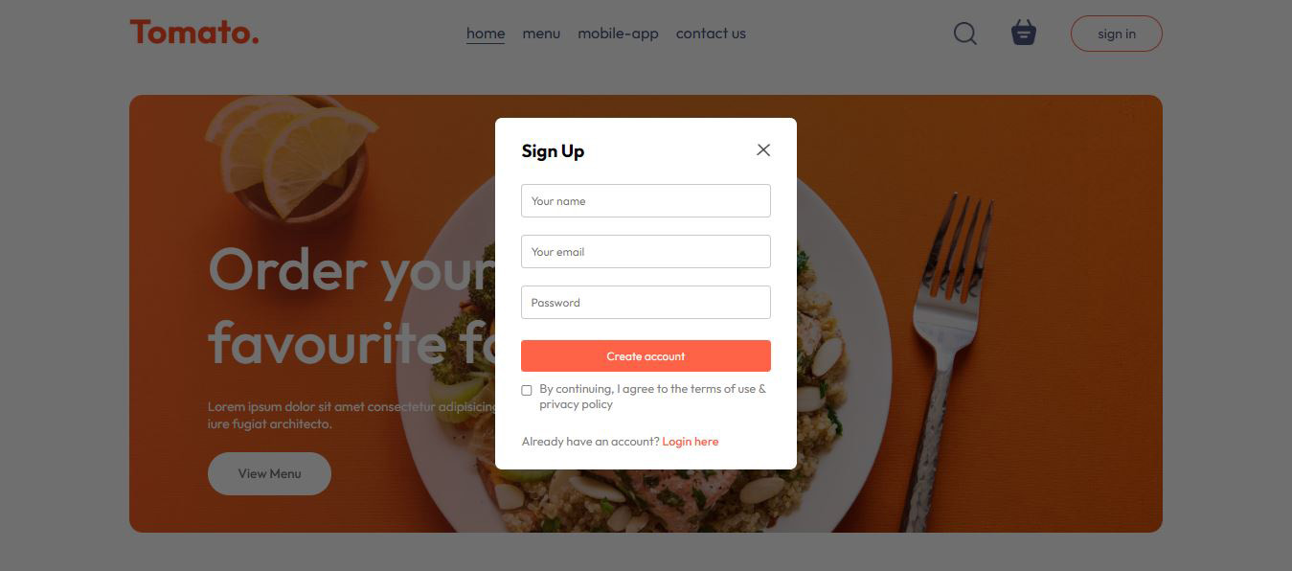
Modelling & Result

Slide 10
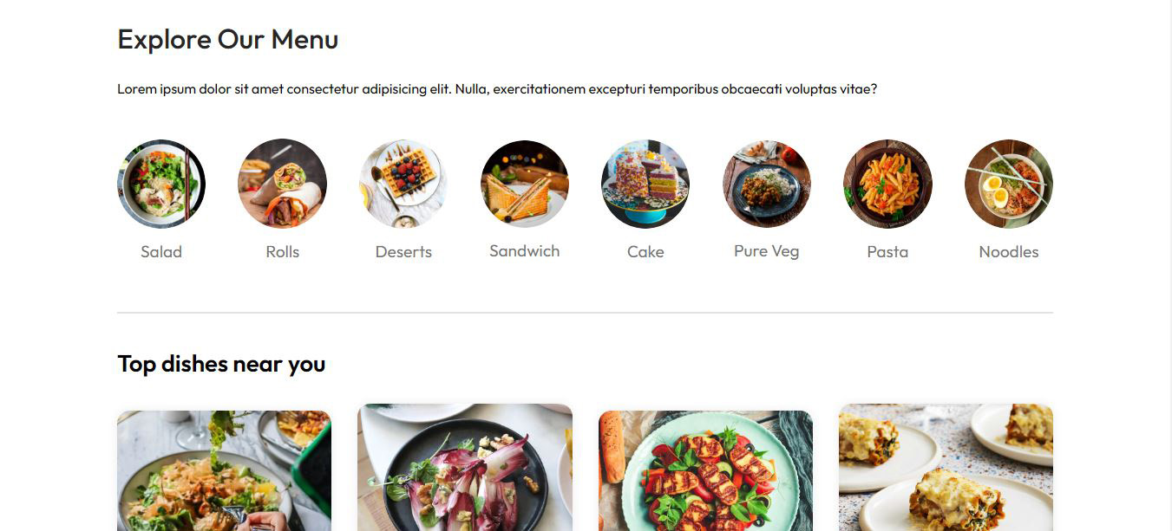
Modelling & Result

Slide 11

Conclusion
Easy Food Ordering – Users can browse menus, add items to the cart, and place orders easily.
Secure Payments – Ensures safe and hassle-free transactions.
Real-Time Tracking – Customers can track their orders live.
Efficient Management – Restaurants can handle menus and orders smoothly.
User-Friendly Interface – Simple and responsive design for a better experience.
Fast & Scalable – The MERN stack ensures high performance and future growth.

Slide 12


Notes:
Thank You !!

